Slide 1
PROJECT PRESENTATION
HR Employee Attrition & Retention Dashboard
Why employees leave, and which groups are most at risk
TEAM
Sandra Hany
Ahmed Samy
Haneen Tarek
Arsany Hany
Alzahraa Hassan
Data prep
Model & DAX
Dashboard
Analysis & QA
Documentation
Notes:
Introduce the project and the team. Add each member’s role once the team confirms them.

Slide 2
Business problem and objectives
237
employees left
Questions HR needs answered
1
Which employee groups leave the most?
1,470
total employees
2
What drives attrition: overtime, pay, tenure, travel, age, marital status?
3
Which departments and job roles are hit hardest?
16.12%
attrition rate
4
What actions can reduce attrition?
Notes:
The company lost 237 of 1,470 employees. HR needs to know where to act first.

Slide 3
Dataset overview
Demographics
Job
1,470
Age group, gender, marital status, education
Department, job role, job level
employees,
one row each
Compensation
Work conditions
Monthly income, stock options
Overtime, business travel, job satisfaction
Cleaned file:
HR_Employee_Attrition_Cleaned
Tenure & career
Outcome
Years at company, last promotion, companies worked
Attrition status: Left or Stayed
Notes:
One row per employee. Source: IBM HR Analytics Employee Attrition & Performance (Kaggle), fictional data. 32 columns, no missing values or duplicates.

Slide 4
Preparing the data for analysis
Cleaned in Power Query, then grouped into bands so patterns are easy to compare
Age group
Income band
Tenure
Since promotion
Under 30
Under 3K
0-1 yrs
0
30-39
3K-6K
2-5 yrs
1
40-49
6K-10K
6-10 yrs
2
50+
10K+
10+ yrs
3
4-5
6+
Attrition stored as Left / Stayed · codes labeled (e.g. Job Satisfaction 1 – Low to 4 – Very High)
Notes:
List the exact Power Query steps here once the team confirms them (types, duplicates, missing values, renames).

Slide 5
Data model
Fact_Employee
Dim_Job
Measures_HR
One row per employee: demographics, income, tenure, attrition
Department, job role, job level
All DAX measures
Progress Axis
Helper table
Notes:
Star-style model. Add relationship keys and cardinality from Model view.

Slide 6
DAX measures and KPIs
1,470
1,233
16.12%
Total Employees
Active Employees
Attrition Rate = Left ÷ Total
83.9%
$6,503
30.5%
Retention Rate = Active ÷ Total
Average Monthly Income
Overtime Attrition Rate
Notes:
Attrition rate = employees who left divided by total employees, for whatever group is shown.

Slide 7
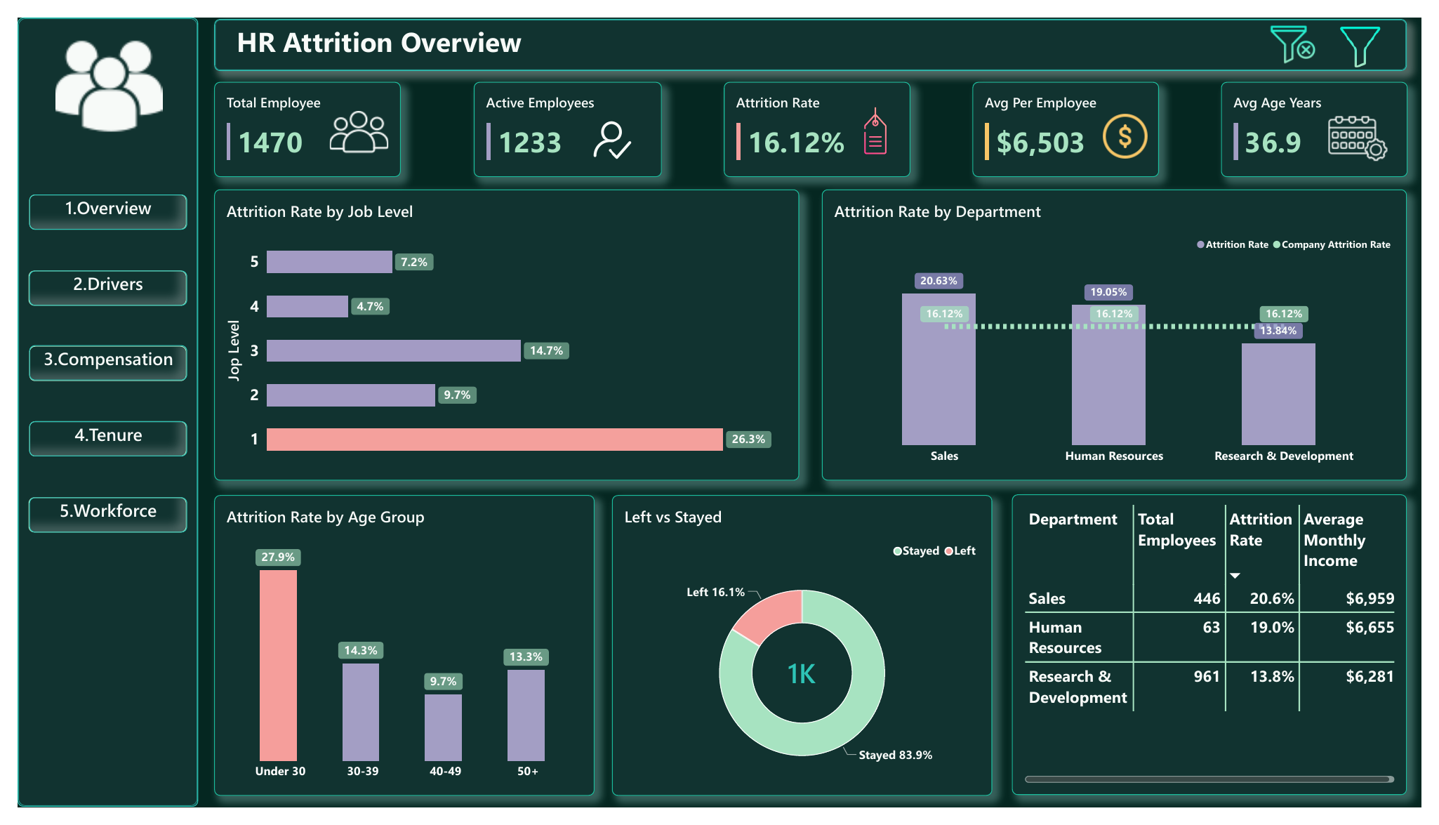
Dashboard overview
1
Overview
KPIs, job level, department, age
2
Drivers
Tenure, income, travel, marital, overtime
3
Compensation
Pay, job role, stock options, satisfaction
4
Tenure
Years, promotions, companies worked
5
Workforce
Headcount by role, age, gender
6
Insights
8 findings with actions
Overview page
Notes:
Walk through the pages with the navigation buttons. Update the screenshot if the dashboard changes.

Slide 8
Who leaves: attrition by group
Overtime workers
28% of staff but 54% of all leavers
New hires
4× the exit rate of staff with 10+ years (34.9% vs 8.1%)
Notes:
Single + overtime is the highest-risk segment at 49.6%. Small groups: Sales Rep n=83, single+overtime n=131.

Slide 9
Recommendations and limitations
Recommended actions
Limitations
Strengthen onboarding in months 1-12
Rebalance overtime and workloads
Review pay and career path for Sales Representatives
Benchmark entry-level salaries
Target single + overtime staff first
One snapshot, no trend over time
Shows association, not cause
Small groups: read with caution
No recorded reason for leaving
Notes:
Recommendations come from the Insights page. Limitations are listed in the Project Booklet.

Slide 10
Conclusion
1
2
3
Where
Why it matters
What next
New hires, overtime workers, low earners, under-30s and Sales Representatives leave most
Single employees working overtime lose about half of their people (49.6%)
Fix onboarding, overtime and entry-level pay first, then track the dashboard
Notes:
Close with the value of the dashboard: HR can now see where attrition is concentrated and act on it.

